Slide 1


One possible learning situation that we will study together
Which padlock is more secure ?
Academic year 2024-25
Master's Degree in Secondary School Teacher Training

Slide 2

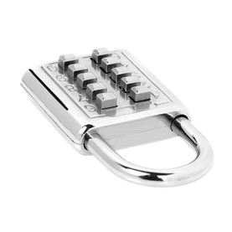

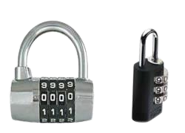

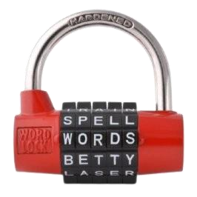
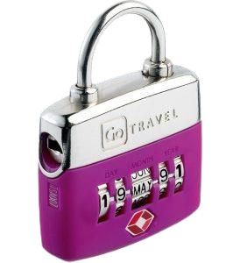



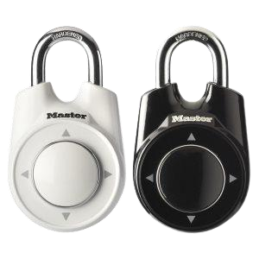
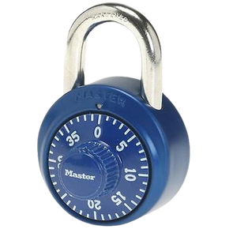
Q₀: Of the following collection of padlocks , which is the most secure ?

Slide 3
Q₀: Of the following collection of padlocks , which is the most secure ?
What issues do you propose to address based on the presentation?
Sharing!
2

Slide 4


Q₀: Of the following collection of padlocks , which is the most secure ?
Vocabulary: words whose meaning needs to be clarified
Code:
Possible password that can be entered into the padlock.
Code elements:
Numbers, letters, symbols,... that make up a code.
Box:
Space (physical or not) in the padlock where the elements of the code are entered.
Elements of the box:
Numbers, letters, symbols,... that can be inserted into a box.
Key or password :
Correct code. When we enter it, the padlock opens.
Code:
1234, 2930, 1240, ... among other possibilities.
Code elements:
The code 1234 has 4 elements: 1, 2, 3 and 4.
Box:
It has 4 squares. Each space where we insert a number
Elements of the box:
Numbers between 0 and 9. Options we have in each box.
Key or password :
4921 (Because when we insert it, it opens)
3

Slide 5

Q₁: How many codes different does each padlock support?
4

Slide 6



Q₁: How many codes different admits each padlock ?
Padlock 1 : Padlock from numbering from roulette
You can choose any 4-digit password.
The squares are rotating discs, with 10 numbers ranging from 0 to 9.
To open the padlock, the discs must be moved so that the password appears correctly located in each of the 4 boxes.
5

Slide 7
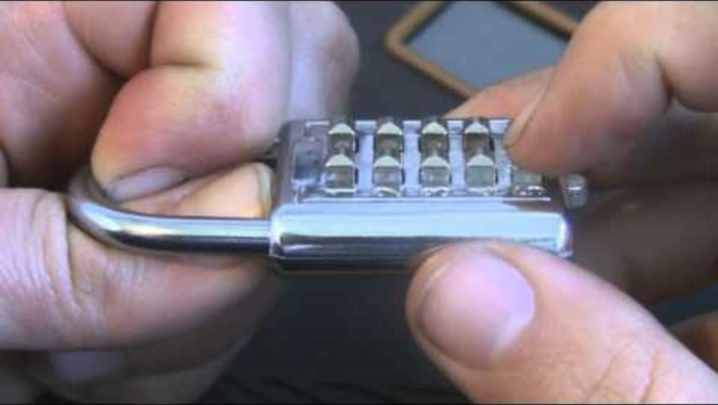

Q₁: How many codes different admits each padlock ?
Padlock 2 : Padlock push button
You can choose a password of a maximum of 3 digits: 1, 2 or 3 digits.
The padlock does not detect the order in which we press the numbers.
To open it, you must slide the bottom tab.
https://youtu.be/zSUG5iQniSc

Slide 8

Q₁: How many codes different admits each padlock ?
Padlock 3 : Padlock with dates
The password can be any date in the format DD – M – YY
Unreal dates are also allowed: 35 – JANUARY – 24
To open it, you must move the discs so that the date is visible, in the positions corresponding to DD, M or YY.
7

Slide 9

Q₁: How many codes different admits each padlock ?
Padlock 4 : Padlock with words
You can choose any password with 5-letter words.
Only 10 letters are available on each disc.
The padlock has no way of checking whether the word entered makes sense or not. Therefore, the password may be a meaningless word.
There are repeated lyrics on the different albums.
To open it, the discs must be moved so that the password appears in the position next to the tab.
8

Slide 10
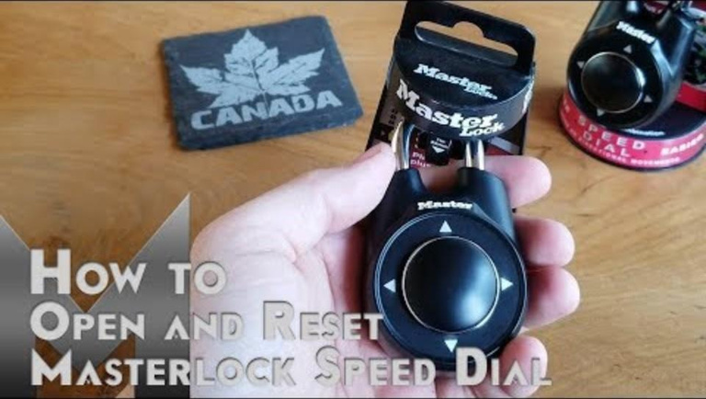
Q₁: How many codes different admits each padlock ?
9
Padlock 5 : Padlock directional
Any 4-direction password can be chosen (up, down, right, left)
A password can have repeated elements.
To enter a new password, you must press twice against the padlock.
When the code is correct, the padlock can be opened.
https://youtu.be/9IAfqFGM56w?t=153
9

Slide 11
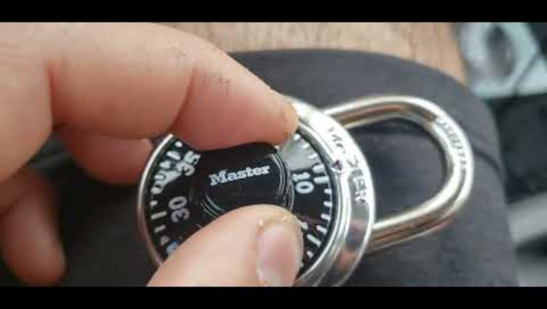
Q₁: How many codes different admits each padlock ?
10
Padlock 6 : Padlock from box strong
You can choose any password with 3 numbers, between 0 and 39.
Password does not support repeated digits.
To enter the password: watch the video
https://youtu.be/ednwKwSu7dw
10

Slide 12
Q₁: How many codes different admits each padlock ?
REPORT Q₁
Q₁: How many different codes does each padlock support?
What are the characteristics of the padlocks you are studying?
How to generate the list (even if it is partial) of possible codes that the padlock supports?
What is the total number of codes that your padlock supports?
What counting strategies or techniques were used?
How did we make sure we didn't overcount or undercount codes?
If we had to open the padlock by trying all the codes, how long do you estimate it would take to open the padlock?
If we have the same padlock with one more box, how many total codes does it have?
What if we have one more element per box? What would happen then?
Prepare a presentation to share the results with the other teams.
10

Slide 13
Sharing!
Q₀: Of the following collection of padlocks , which is the most secure ?
4

Slide 14
We've been given more information about the password...
Q₂: Can we find the number of codes with the new information ?

Slide 15
Q₂: Can we find the number of codes with the new information?
Padlock 7: Roulette numbering padlock (no repeats)
We know that the password does not contain repeated digits
Padlock 10: Directional padlock (no repetitions)
Padlock 8: Push-button padlock (extended)
We now know that the password does not contain repeated addresses
We know for sure that the password has 7 digits.
Padlock 11: Safe padlock (with repetitions)
Padlock 9: Date padlock (no repeats)
We know that the password does not contain repeated addresses
We know that neither days nor years contain repeated numbers.

Slide 16
Q₂: Can we find the number of codes with the new information?
Q₂ REPORT
Q₂: Can we find the number of codes with the new information?
What are the characteristics of the padlocks you are studying?
How to generate the list (even if it is partial) of possible codes that the padlock supports?
What is the total number of codes that your padlock supports?
What counting strategies or techniques were used?
How did we make sure we didn't overcount or undercount codes?
If we had to open the padlock by trying all the codes, how long do you estimate it would take to open the padlock?
If we have the same padlock with one more box, how many total codes does it have?
What if we have one more element per box? What would happen then?

Slide 17
Q₃: What characterizes a padlock model ?
What models are there?
What do we call them?

Slide 18
Q₃: What characterizes a padlock model ? What models are there? What do we call them?
REPORT Q₃
Q₃: What characterizes a padlock model? What models are there? What do we call them?
Are there strategies shared by different padlocks?
What classification originates from the different strategies?
What numerical/algebraic formulas can be deduced from the strategies?
What variables appear?
What models are there?
What characterizes each model?
What do we call them?

Slide 19





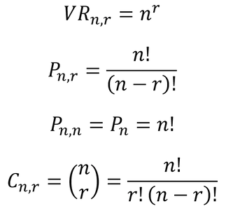


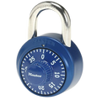







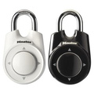
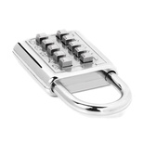


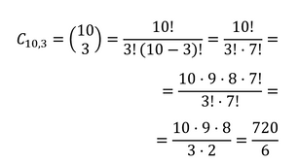

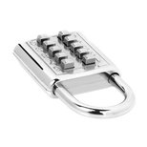
Q₃: What characterizes a padlock model ? What models are there? What do we call them?
r boxes
n elements in each box
Model name
Formula
Answer the question...
Variation with repetition of n elements considered from r to r.
In how many different ways can we choose codes? with r boxes in elements in each box and if we can repeat elements ?
Roulette numbering padlock
Yes
Combinations of 4 numbers can be chosen.
Each box has 10 elements.
A combination can have repeated elements.
Safe padlock
CAN THEY BE REPEATED?
Yes
In how many different ways can we choose codes with r boxes and n elements in each box, if we cannot repeat elements ?
Combinations of 3 numbers can be chosen.
Each box has 40 elements.
A combination cannot have repeated elements.
Variation without repetition of n elements considered from r to r.
No
DOES IT INFLUENCE ORDER?
Directional padlock (restrictions)
In how many different ways can we sort a given code of n elements?
(Particular case)
You can choose combinations of 4 elements ⬆️⬇️➡️⬅️
A combination cannot have repeated elements.
Permutation of n elements
Push-button padlock
In how many different ways can we choose combinations with r squares and n elements in each square, if the combinations cannot repeat elements and the order of the elements is indifferent ?
There are 10 keys to choose from, of which only 3 must be chosen.
Combinations with the same numbers, but out of order, count as the same combination.
No
Combination of n elements considered from
r in r.

Slide 20
Q₄: Do these models work to solve more problems with contexts other than padlocks?

Slide 21
Q₄: Do these models work to solve more problems with contexts other than padlocks?
REPORT Q₄
Q₄: Do these models work to solve more problems with contexts other than padlocks?
How many different ways are there to...
Elect a president, secretary and spokesperson from a group of 12 people if one person cannot hold more than one position.
Elect a president, secretary and spokesperson from a group of 12 people if one person can hold more than one position.
Form words of three different letters with the letters of the word PERMUTATION.
Paint a flag with 3 available colors in a horizontal arrangement and we must use a minimum of 2 and a maximum of 3, and the colors cannot be repeated.
Choosing an ice cream if there are 6 different flavors and we are allowed to choose 2 different flavors.
With 4 cans of paint of different colors, how many mixtures of 2 different colors can we make?
Answer 4 questions from a list of 5.
Assign 2 twin brothers so that they do not coincide in the same class if the school has 4 3rd ESO classes.
Assemble a bead bracelet if we have 10 beads available, all of different colors.
Organize homework for 3 subjects in one afternoon.
Combine 10 t-shirts for a week so as not to repeat a t-shirt any day of the week.
Combine the shirts from the previous case with 3 pairs of pants
Make vehicle registration plates that consist of 4 numbers and 3 letters of the alphabet, excluding vowels.

